Slide 1

Auto-Gist the News
Automatic News Summarization

Slide 2
Motivation
01
Importance of News
It’s important to stay up to date for events happening around the world.
02
Lack of Time To Read The News
Most of people wants to read the news but cannot due to lack of time.
03
Need Precise & Concise News
The news should be accurate and succinct to read.

Slide 3
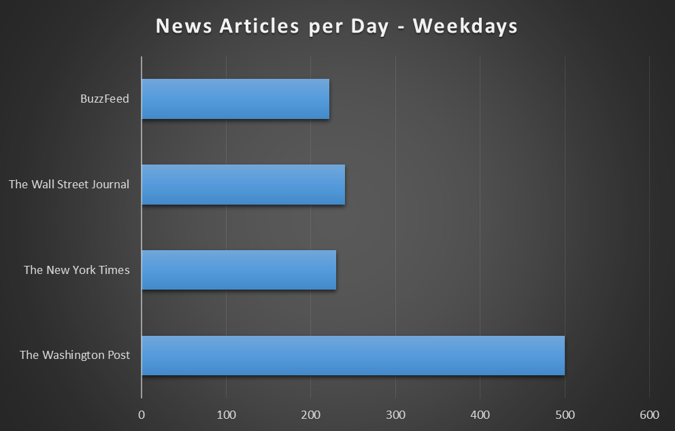
Why need Automatic News Text Summarization?
Lots of Data Everyday
Lot of articles get printed or posted daily with an average of 200.
Making everything automatic makes it easier and faster for everyone.
Automatic Summarization will lessen the human efforts.

Slide 4
Summarization types
01
Extractive Summarization
Most relevant and important are identified and extracted to generate the summary.
Types
02
Abstractive Summarization
Sentences are generated from content maintaining the relevance, the meaning

Slide 5
Dataset
CNN and Daily Mail
Text column that contains news.
Highlight column that can be used as reference for summary.
300K
31% from CNN and 69% from daily mail

Slide 6
Implementation
Collect the data
Data PreProcessing
Data cleaning
News Articles
Train a model
BART, PEGASUS
Improve
Evaluate the model
Tuning
Rouge Score

Slide 7
Data Cleaning
Remove Non-Ascii characters
01
àA string# asfec withé fuünny charactersß.
A string# asfec with funny characters.
Convert to lower case
02
a string# asfec with funny characters.
A string# asfec with funny characters.
Remove all Non-english words
03
a string# with funny characters.
a string# asfec with funny characters.
Remove special characters
04
a string with funny characters.
a string# with funny characters.
Remove excessive space
05
a string with funny characters.
a string with funny characters.

Slide 8
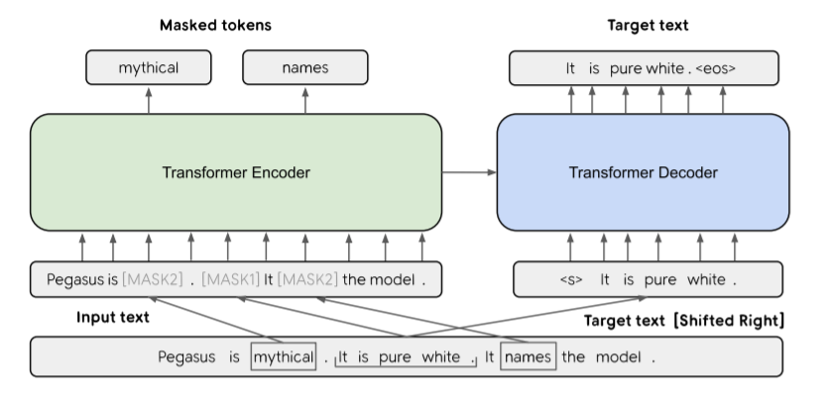
PEGASUS (Pre-training with Extracted Gap-Sentences)
01
02, 03
One sentence is masked with [MASK1] and used as target generation text (GSG).
The other two sentences remain in the input, but some words are randomly masked by [MASK2] (MLM)

Slide 9
BART (Bidirectional and Auto-Regressive Transformer)
BERT
Encoder
BART
Transformer model
GPT-2
Decoder

Slide 10
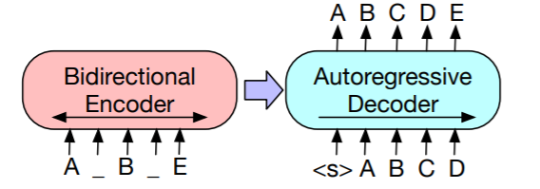
BART Architecture
A Denoising Autoencoder
Sequence to sequence model.
BERTlike encoder.
An autoregressive GPTlike (left-to-right decoder) decoder.
Why not single directional?

Slide 11
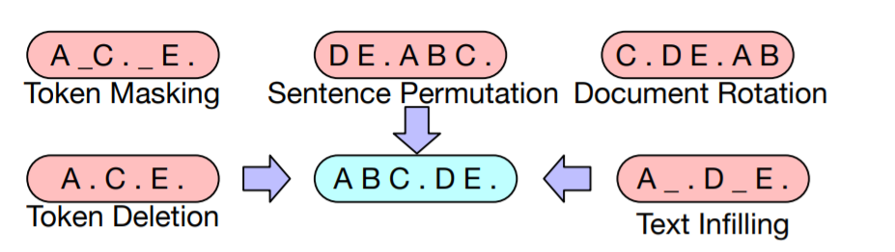
BART LAYERS
Mobile banking
Token Masking random tokens are sampled and replaced with [MASK]
Token Deletion is the same as masking but the sampled token is deleted and the model will add a new token at those places.
Token Infilling a number of text spans, i.e. contiguous group tokens, are sampled, and then they are replaced by the [MASK] token.
Sentence Permutation random shuffling of the sentences from text.
Document Rotation a token is chosen randomly to be the start of the document, the section before the starting token is appended at the end.

Slide 12
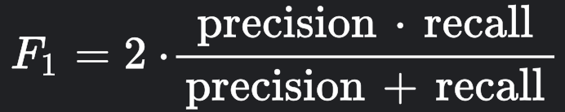
Which sentences are important?
F1- Measure
Rouge Score
Recall
Number of Overlapping words
Recall-Oriented Understudy for Gist Evaluation
Total words in reference summary
Precision
Number of Overlapping words
Total words in system summary
Reference Summary
System Summary

Slide 13
What is Rouge Score?
01
Rouge-N
02
Rouge-L
Rouge Score
N-gram
Longest Matching Sequence
03
Rough-S
Skip-gram occurrences

Slide 14
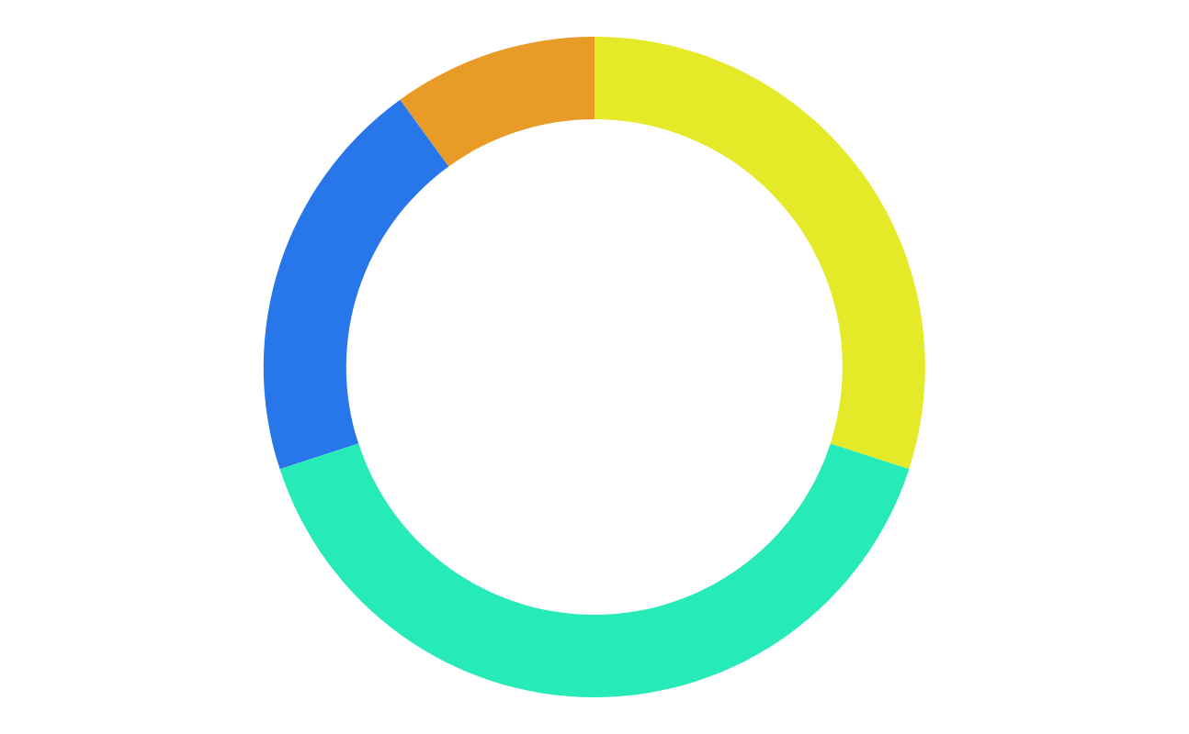
Next Steps
1.
3.
Tuning
Summary Comparison
Changing model parameters
BART and PEGASUS model generate summary
2.
4.
Different dataset
Visuals Generation
Model training on dataset
Loss graph, different n-grams, Effect on Rogue score when summary words tuning

Slide 15
Conclusion
It can be said that the abstractive summarization models work on machine learning and deep learning models which can generate the summary in a meaningful way.
Generated summary’s context may differ from the actual context or article given but try to give gist of the entire article.
Abstractive summarization model may generate the summary based on its own interpretation to make it more suitable and reflect the idea of the article as a whole.

Slide 16

Thank you!
Bansi Mehta (bansi.mehta@dal.ca)
Deep Patel (deep.patel@dal.ca)
Janvi Patel (janvi.patel@dal.ca)
Sanket Shah (sanket.shah@dal.ca)

